Slide 1

MMORPG Database Concept and Implementation
Alekzander Green
ACS 575 – Dr. Yoo

Slide 2
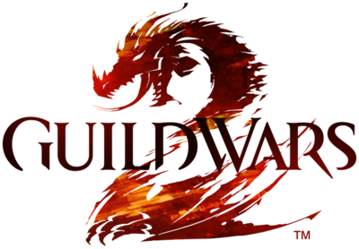

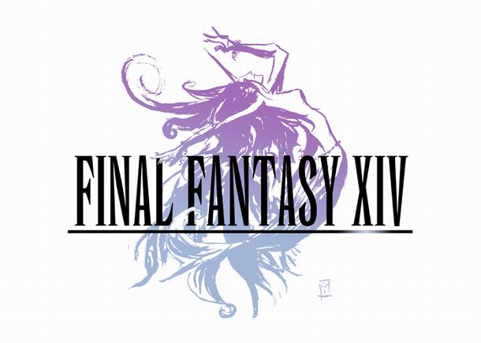

Introduction and Motivation
Concept for an MMORPG database capable of saving information related to items, characters, and more
Huge MMORPG fan
Could evolve into a fully functional database for future projects
Personally want to use many ORDBMS elements

Slide 3
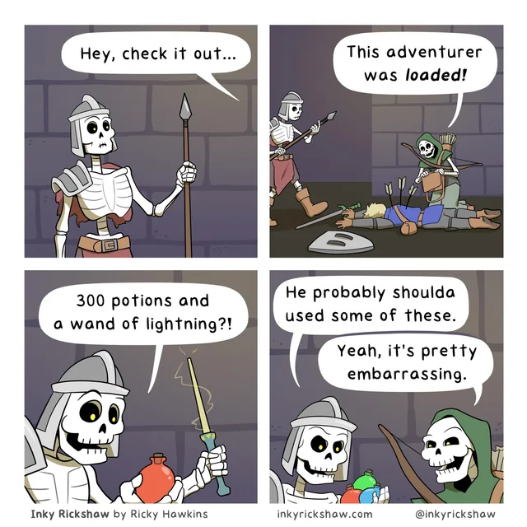
Problem Statement
MMORPGs need to store a lot of data
A large portion of the game is related to collecting or finding new items to use
Need to store not only item information, but:
Inventories
Banks
Equipped items
Additionally, items come in many forms with different uses

Slide 4
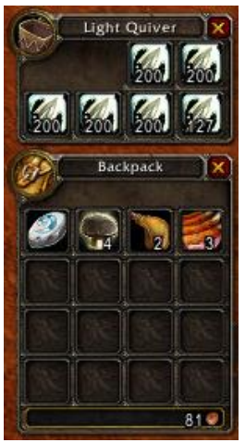
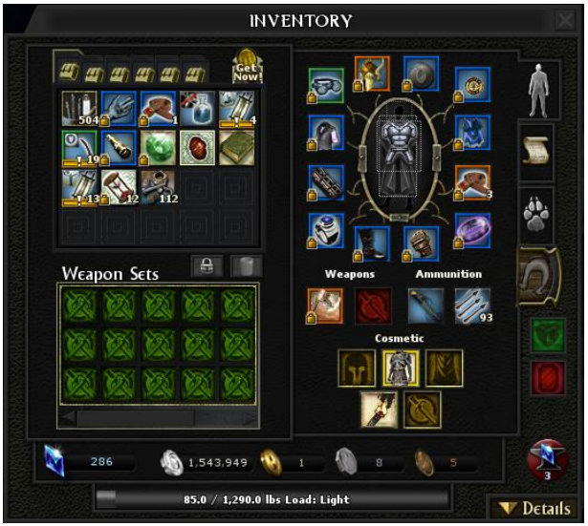
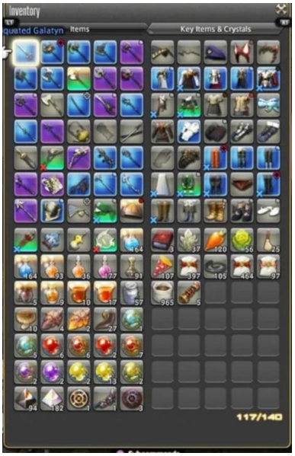
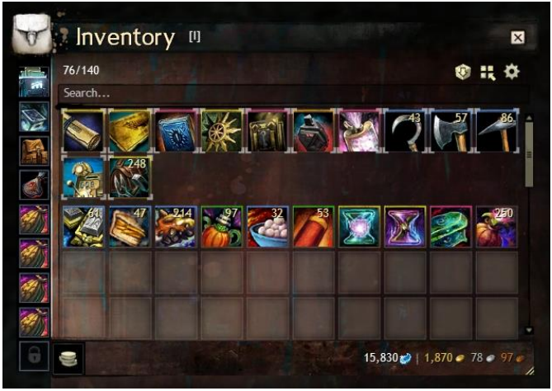
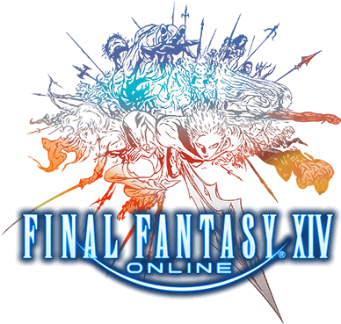
Market Research

Slide 5
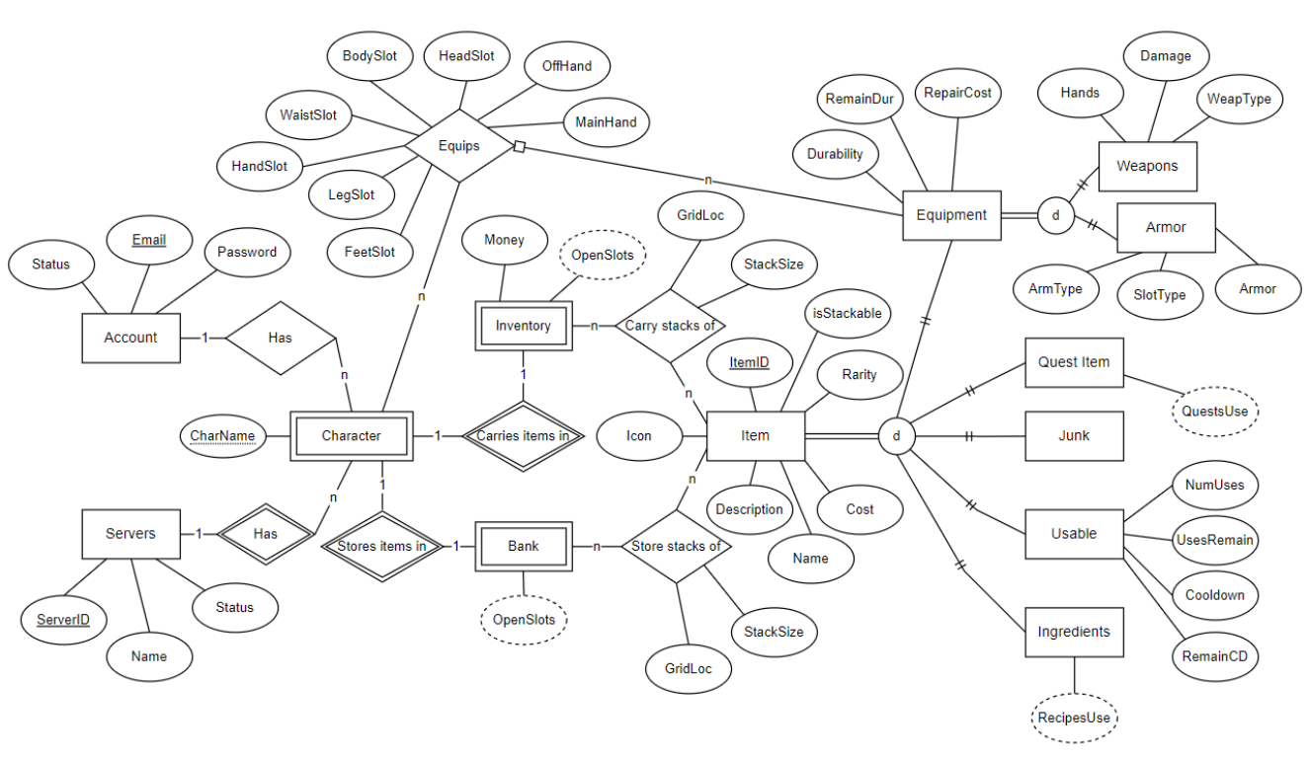
Conceptual Schema

Slide 6
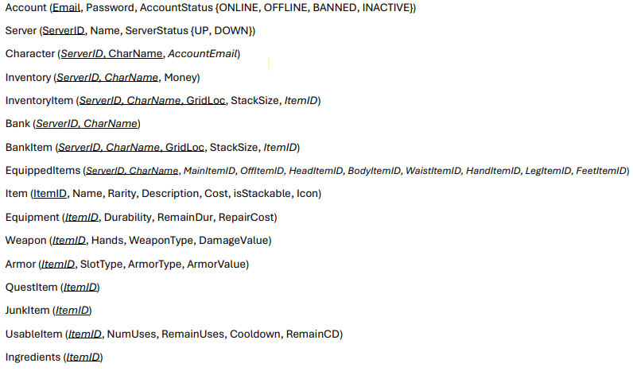
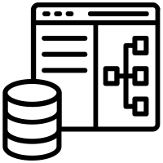
Logical Schema (Relational-Only)

Slide 7
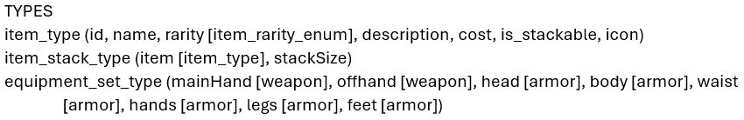
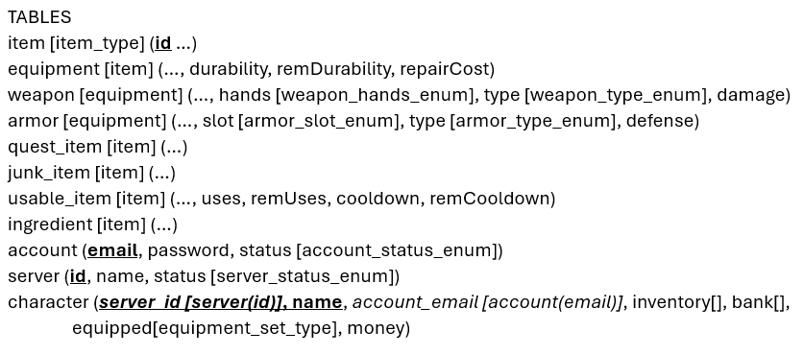

Logical Schema (Object-Relational)

Slide 8

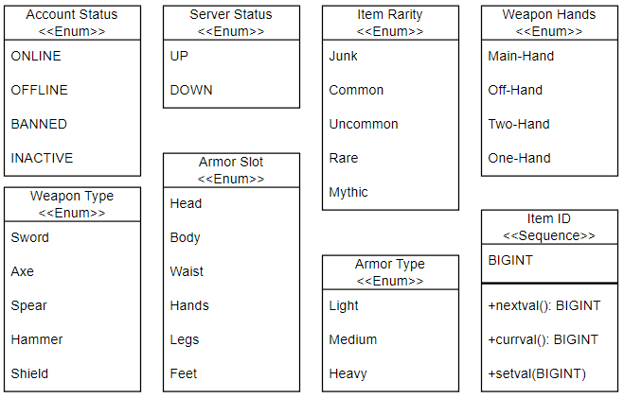
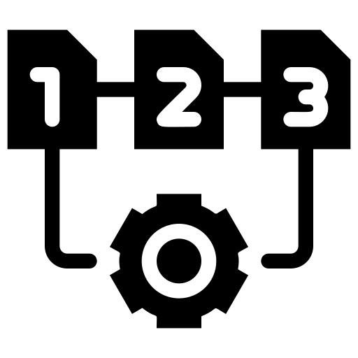
Physical Schema (Enums & Sequences)

Slide 9
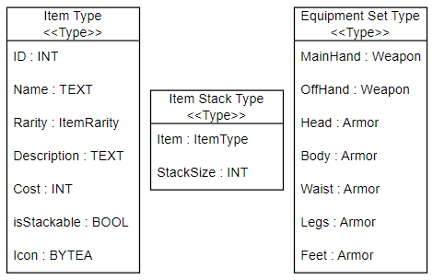

Physical Schema (Types)

Slide 10
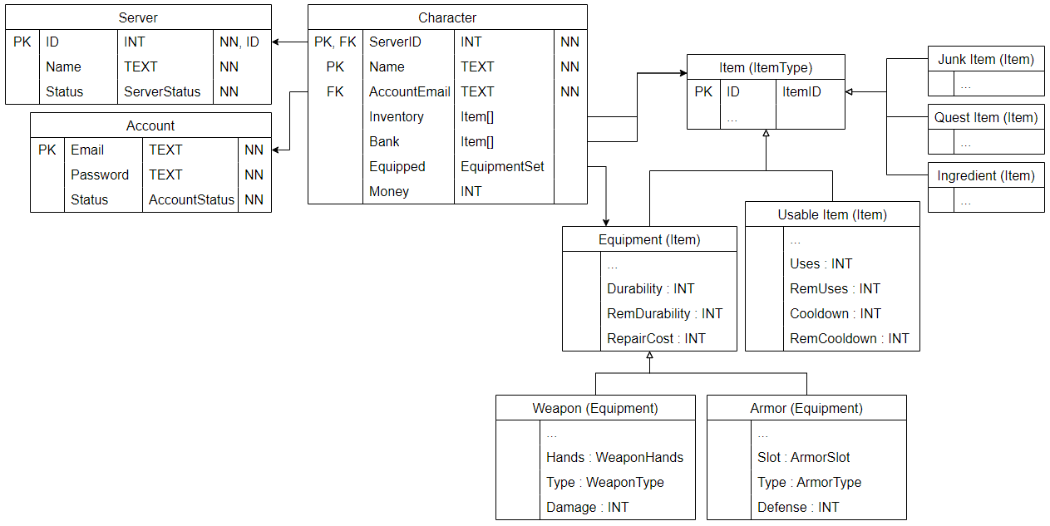

Physical Schema (Tables)

Slide 11
System Architecture
PostgreSQL
(Database Server)
FastAPI-Uvicorn
(Application Server)
Demo App.
(Client)
Prototype System (Three-Tier)

Slide 12

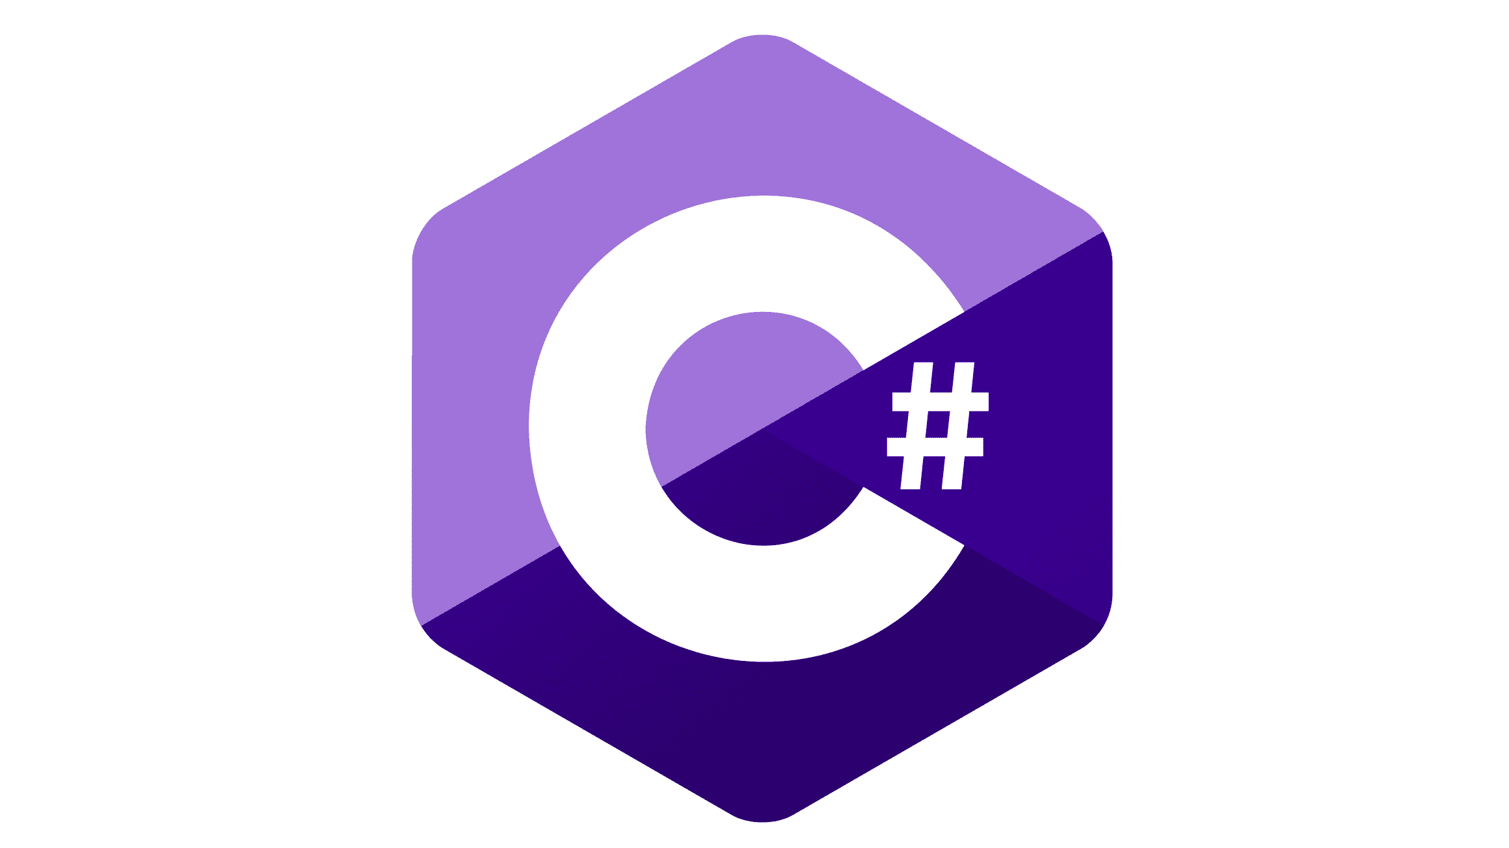





DBMS Technology and Development
PostgreSQL
pgAdmin4
FastAPI (Python)
Uvicorn (Python)
Psycopg2 (Python)
Visual Studio
Windows Form App (C#)
Frontend
Frontend
Backend
Backend
Database
Backend
Backend

Slide 13

Functionalities
Strong inheritance between items for simple querying
Innate grid system for inventories and banks using arrays
Simple actions using stored procedures and UDFs
Strong use of enums for input checking
Asynchronous connection pooling

Slide 14
CRUD Operations
C
R
U
Create Accounts
Read Account login info
Update Account statuses
Read Server statuses
Update Server statuses
Create Characters
Read all Character inventory spaces
Update all Character inventory spaces
Create new Items in the database
Read Item stats
Update dynamic Item stats
Delete Characters
R
U
C
R
U
D
C
R
U

Slide 15
Prototype System
Database
Adapter
Backend
API
Backend
Server
Desktop
Client
DBMS
Limited functionality
User lookup
Character list retrieval
Item list retrieval
Inventory retrieval
Add items to inventory
Remove items from inventory

Slide 16
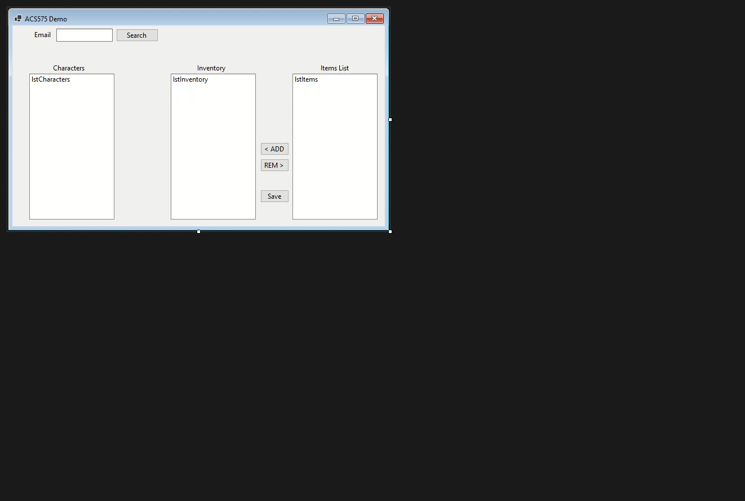


Demo (Application)

Slide 17

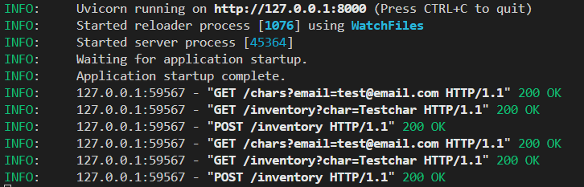
Demo (Server)

Slide 18

Conclusion and Future Work
A comprehensive database for an MMORPG is feasible
A database and backend API was successfully created
Object-relational systems can be very useful when used correctly
UDFs and stored procedures make developing APIs much simpler
Integrate the database with an MMORPG project
Develop systems for authentication
Consider migrating to a production-level API like Django

